Slide 1
Two-body sfermion decays at full one-loop level within the MSSM
Mgr. Hana Hlucha

Slide 2
Why Supersymmetry?
Theoretical considerations (symmetries)
Unification with gravity
Gauge coupling unification
Hierarchy problem
Electroweak symmetry breaking
Dark matter
Susy has already made several correct predictions
(light Higgs boson, heavy top quark, …)
Mgr. Hana Hlucha
1/26

Slide 3
Supersymmetric lagrangian
Mgr. Hana Hlucha
2/26

Slide 4
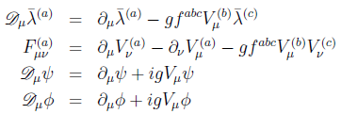
Supersymmetric lagrangian
MSSM – one set of Susy generators
– minimal choice of the Higgs sector
Mgr. Hana Hlucha
3/26

Slide 5
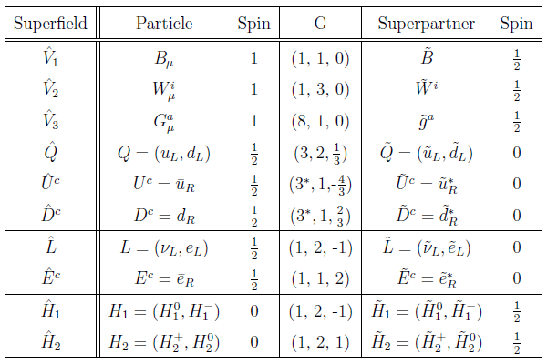
MSSM field content
Mgr. Hana Hlucha
4/26

Slide 6
MSSM lagrangian
soft – no dimensionless couplings that would
reintroduce quadratic divergencies
Mgr. Hana Hlucha
5/26

Slide 7
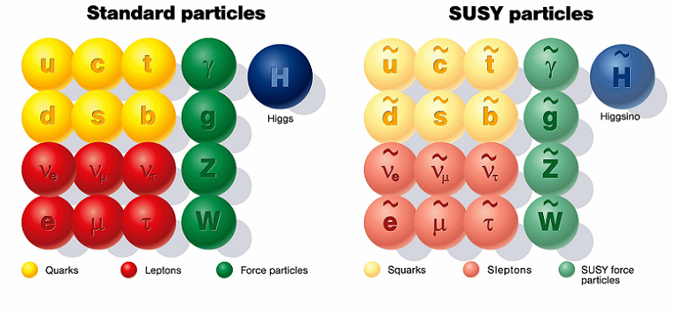
Particle spectrum of the MSSM
5 Higgs bosons (3 neutral, 2 charged)
4 neutralinos
2 charginos
Mgr. Hana Hlucha
6/26

Slide 8
Raise of MSSM soft terms
Indirect or radiative
SB in a hidden sector; mediated to the visible sector
by some interaction:
- gravitational (CMMSM)
- ordinary EW or QCD (GMSB)
- bulk mediation (AMSB)
Mgr. Hana Hlucha
7/26

Slide 9
Renormalization of the MSSM
First step – regularization of divergent parts
Two types of divergencies:
- infrared (regularized by small photon (gluon) mass)
- ultraviolet (dimensional reduction)
Second step - renormalization
Mgr. Hana Hlucha
8/26

Slide 10
DREG vs. DRED
DREG does not respect SUSY (D-dimensional V field)
DRED: integration momenta are D-dimensional, all
other tensors and spinors are kept 4-dimensional
For the validity of field equations and gauge invariance
one must impose the identity
At one-loop level, the difference is only in finite terms
example
Mgr. Hana Hlucha
9/26

Slide 11
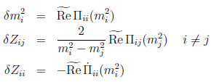
Renormalization of the MSSM
Renormalization of scalars
Mgr. Hana Hlucha
10/26

Slide 12
Renormalization of the MSSM
Charge renormalization
Strong coupling renormalization
Mgr. Hana Hlucha
11/26

Slide 13
Renormalization of the MSSM
Sfermion sector
Mgr. Hana Hlucha
12/26

Slide 14
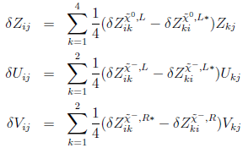
Renormalization of the MSSM
Neutralino and chargino sector
Mgr. Hana Hlucha
13/26

Slide 15
Renormalization of the MSSM
Higgs sector
Mgr. Hana Hlucha
14/26

Slide 16
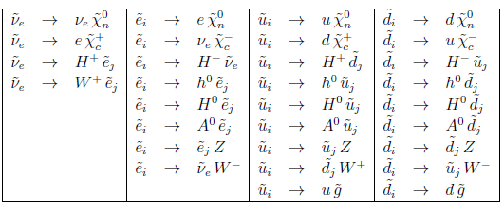
Sfermion two-body decays
Mgr. Hana Hlucha
15/26

Slide 17
Soft photon radiation
The soft photon cross section (or decay width) is
proportional to the Born cross section
Adding the soft photon cross section to the one loop
corrected cross section, the result is free of the
parameter λ.
Mgr. Hana Hlucha
16/26

Slide 18
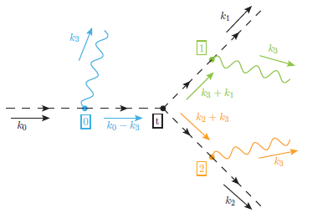
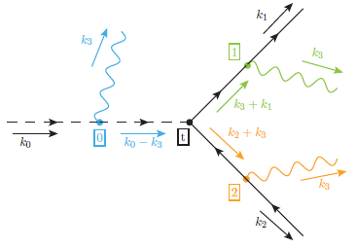
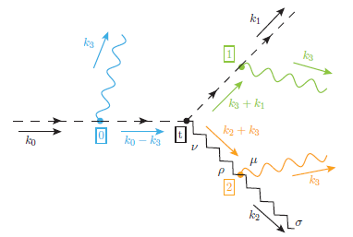
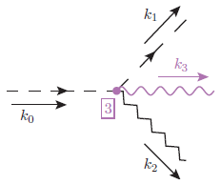
Hard photon radiation
Mgr. Hana Hlucha
17/26

Slide 19
Program SFOLD (main part of the thesis)
Written in F77 (little part in C)
First step: fully automatic generator in Mathematica
together with supplementary files in F77
Used packages: FeynArts, FormCalc, LoopTools
Full QCD and EW corrections at one-loop level
UV and IR check
Dependence on ξ_{w,} ξ_{z}
Possibility to work in Mathematica
User friendly
Mgr. Hana Hlucha
18/26

Slide 20
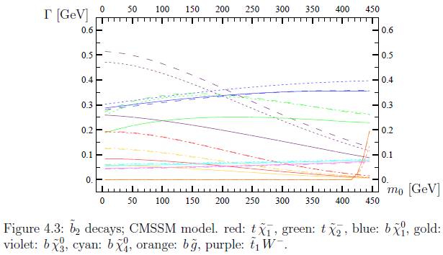
Numerical results (sbottom 2)
tree : dotted
sqcd: dashed
full : solid
Mgr. Hana Hlucha
19/26

Slide 21
Numerical results (sbottom 2)
sb2 → W: (CMSSM, m0 = 50):
tree | sqcd | full
0.47462 | 0.51681 | 0.25940
0.47462 | 0.51681 | 0.44291
0.47462 | 0.48132 | 0.27225
all particles
all particles without G
only G and stop1
sb2 → cha1: (CMSSM, m0 = 50):
tree | sqcd | full
0.18868 | 0.19043 | 0.08257
0.18868 | 0.19043 | 0.16361
0.18868 | 0.18868 | 0.08239
all particles
all particles without G
only G and stop1
Mgr. Hana Hlucha
20/26

Slide 22
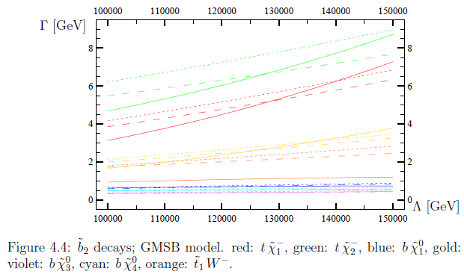
Numerical results (sbottom 2)
tree : dotted
sqcd: dashed
full : solid
Mgr. Hana Hlucha
21/26

Slide 23
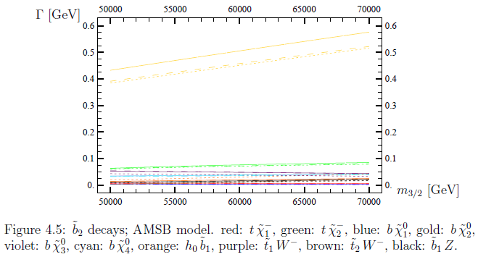
Numerical results (sbottom 2)
tree : solid
sqcd: dashed
full : dotted
Mgr. Hana Hlucha
22/26

Slide 24
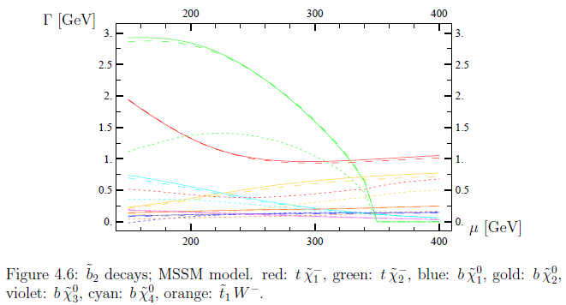
Numerical results (sbottom 2)
tree : solid
sqcd: dashed
full : dotted
Mgr. Hana Hlucha
23/26

Slide 25
Numerical results (sbottom 2)
sb2 → cha1: (MSSM, mu = 220):
tree | sqcd | full
1.18706 | 1.18153 | 0.40506
1.18706 | 1.02264 | 0.34001
1.18706 | 1.02264 | 0.76872
all particles
only G, stop1, stop2, sb2
only stop1, stop2, sb2
sb2 → cha2: (MSSM, mu = 220):
tree | sqcd | full
2.78947 | 2.76213 | 1.44066
2.78947 | 2.51163 | 1.35881
2.78947 | 2.51163 | 2.08257
all particles
only G, stop1, stop2, sb2
only stop1, stop2, sb2
Mgr. Hana Hlucha
24/26

Slide 26
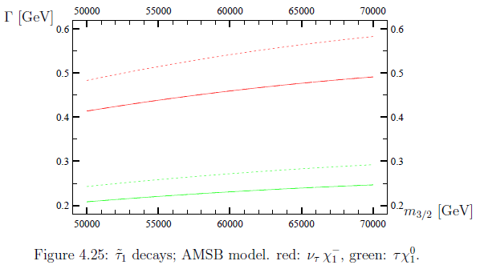
Numerical results (stau 1)
tree : solid
sqcd: dashed
full : dotted
Mgr. Hana Hlucha
25/26

Slide 27
Conclusions
We calculated two-body decay widths to all sfermions
in the MSSM model at the full one-loop level
including electroweak corrections
We thus renormalized all sectors in the MSSM model
We provided the user friendly package named SFOLD
scientists can compare their results to.
Mgr. Hana Hlucha
26/26

Slide 28
Thank you for your attention!

